Slide 1
Terra Dotta Administrative Tricks
HEIBO conference, October 4-6, 2017

Slide 2
Presenters
Danette Bontrager, Iowa State University
Kerry Geffert, Terra Dotta

Slide 3
Background
Iowa State University
36,660 students
1700 students study abroad annually
Decentralized model
Billing is done by the college administering the program or the Study Abroad Center
Study Abroad Center bills for its programs as well as two colleges
Terra Dotta
Software used by 575 educational institutions
Leader in education abroad software

Slide 4
Billing Procedure Comparison
Before Terra Dotta Software (TDS)
Billing was manually entered one student at a time on a mainframe application
Multiple data entry errors as a results
Very time consuming
After Terra Dotta Software (TDS)
Semi-automated
Errors reduced
Errors made now do cascade down to all participants on a program
Minimal time commitment

Slide 5
Billing procedure with TDS
Fees and billing codes stored in Access database
Download from TDS query the applicant data with appropriate billing code, UID, Student Name
Copy info to spreadsheet linked to billing database
May need to make a few manual adjustments for special billing cases (e.g., varying credit levels, different location pricing)
Database query links data in spreadsheet and database table
Check query for any errors or needed adjustments
Run a database macro to pull the query data and put it in a uploadable format
Upload data to ISU billing system
TDS notifies us automatically of billing changes (withdrawals, adds) through Query Watch feature

Slide 6
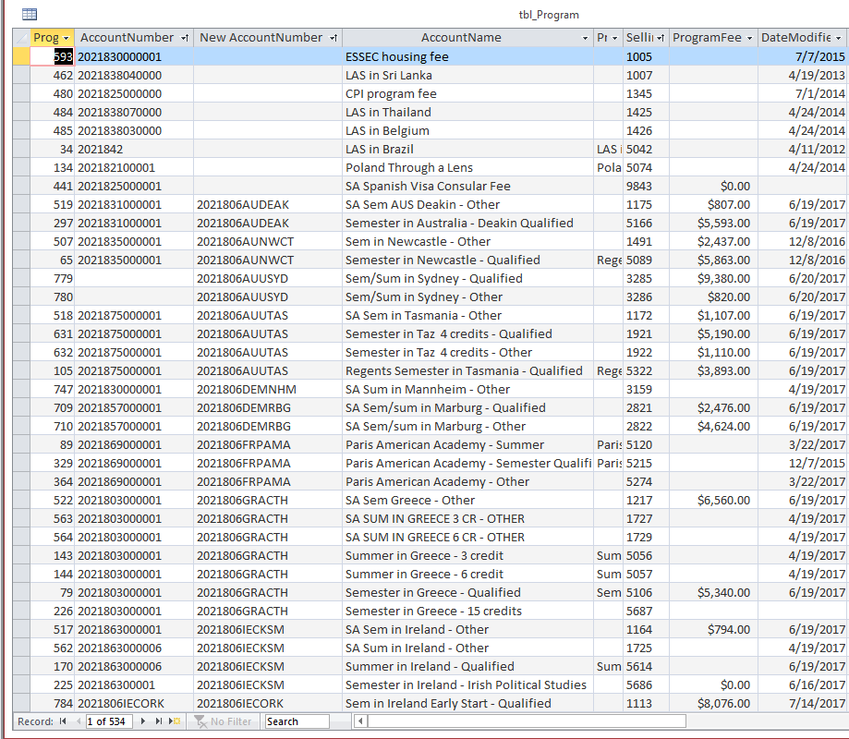
Program Fee Table

Slide 7
TDS Billing Building Blocks
Program parameters
Query for current billing cycle records including these parameters
Create report and export it to Excel

Slide 8
Demonstration
Extract Billing Info from Terra Dotta Report
Copy data from Report to linked billing sheet

Slide 9
Demonstration
Run Billing Query in MS Access to Test Results
Use Macro to Prepare Upload

Slide 10
Hello from Terra Dotta
Make Data Driven Decisions Faster

Slide 11
Who We Are...
Founded in 2001 by two graduate students
Today – Around 60 diverse employees around the country
Over 575 educational institutions and businesses use our software
Mission built on “very best products and services” through “best-in-class technology” and “mutual trust” in our business relationships.
Our solutions: ISSS Study Abroad Travel Risk Agreement/Application Management AlertTraveler
Trends in international education data management

Slide 12
Topics of Interest
Payment Gateways Terra Dotta Support Webinar – Payment Gateways: Streamlining the application payment process Wednesday, November 29, 2017, 4:00 p.m. EST www.terradotta.com/support-webinars.html
Platform Integrations
Budget Sheets
Others? We're listening...

Slide 13
Shameless Plugs
Terra Dotta Boot Camp November 3 - 4, 2017 Denver, CO
TDU Global April 16 – 18, 2018 Pittsburgh, PA
conference.terradotta.com

