Slide 1
ds
The University of Iowa
Study Abroad Withdrawal Policies
October 2016

Slide 2
Agenda
Discuss the different withdrawal policies based on type of study abroad program
Explain why we standardized the withdrawal policy rather than align with cost outlays per program.
Discuss how the withdrawal penalties are processed
Discuss the student appeals process
2

Slide 3
Study Abroad Withdrawal Policies
Study Abroad used to charge deposits
It was assumed that a deposit would show student commitment and discourage withdrawals.
Over the years, the deposit account built a large balance
Reconciliation was time consuming
Process was ineffective

Slide 4
Study Abroad Withdrawal Policies
students continued to withdraw in spite of making a deposit.

Slide 5
Study Abroad Withdrawal Policies
Comprehensive withdrawal policies were needed
Came up with 3 standard withdrawal policies
Faculty Led programs
Exchanges
Other programs

Slide 6
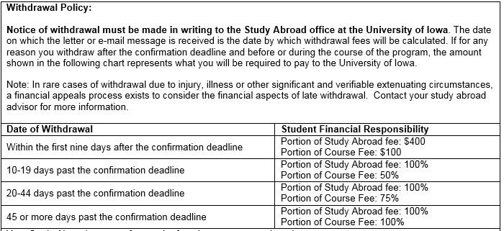
Study Abroad Withdrawal Policies
UI Sponsored Programs (faculty led)

Slide 7
Exchanges
Study Abroad Withdrawal Policies
DRAFT DRAFT DRAFT DRAFT DRAFT DRAFT DRAFT DRAFT DRAFT

Slide 8
Other Provider Programs (CIEE, USAC)
Study Abroad Withdrawal Policies

Slide 9
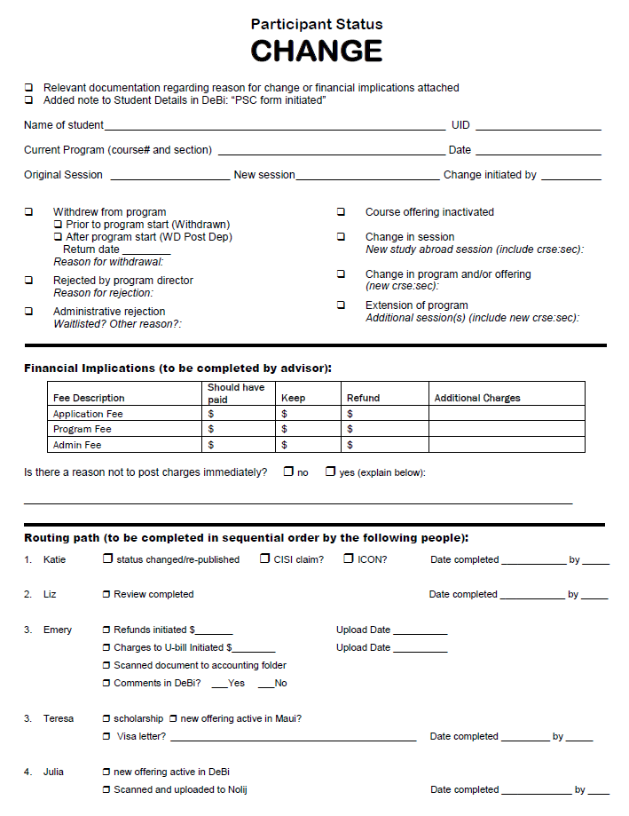
Study Abroad Withdrawal Policies
Processing Charges

Slide 10
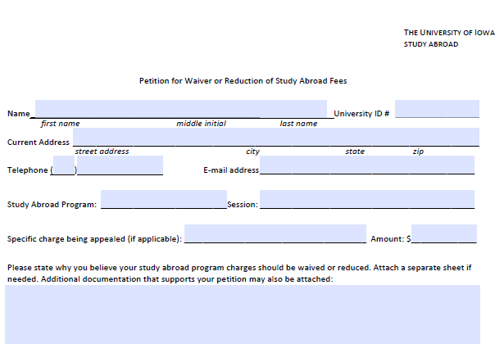
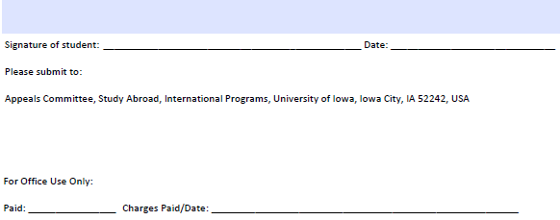
Study Abroad Withdrawal Policies
Appeals Process

Slide 11
Study Abroad Withdrawal Policies
Questions?

