Slide 1
HOW TO MAKE MONEY OPENING A PASSPORT OFFICE

Slide 2
Overview
Why open a passport acceptance facility?
Student Service
Community Service
Revenue Generation
What to expect in your first year
Marketing
Data Gathering
Customer Feedback

Slide 3
Quick Facts- IU
Opened for business May 1, 2017
Applications since “Go-Live”: 357
Photo’s since “Go-Live”: 877
Net Income/loss: Ask me next year!
Staffing Model: 3 part-time (1 supervisor at 28 hrs./wk., 2 assistants at 20hrs./wk.)

Slide 4
Quick Facts- UT

Slide 5
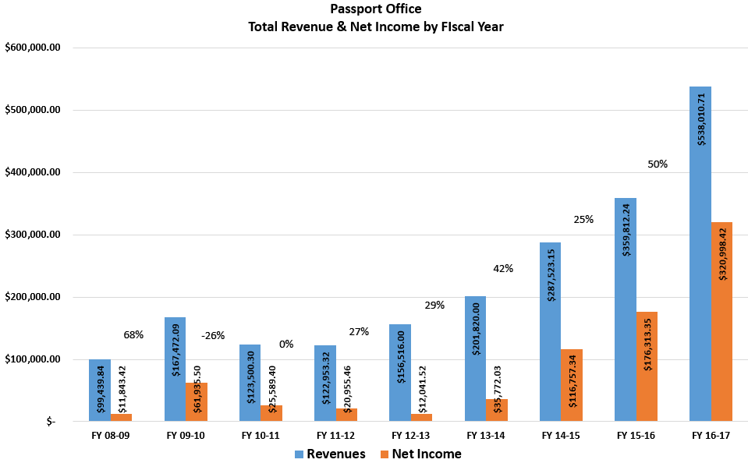
Quick Facts- UT

Slide 6
Quick Facts- UT
Applications FY 16-17: 15,546
Revenues: $538,000 ($389,000, 72% passports, $149,000, 28% photos)
Expenses: $217,012
Net Income: $321,000
Staffing Model: 2-full-time; 3 part-time; 2 to 3 student workers

Slide 7
Quick Facts- UT
Total Expenses: $217,000

Slide 8
Approvals
Approvals
Legal Affairs
Accounting Office
Budget Office
State Department Requirements for Acceptance Facility
Public Sector Entity
Not managed by or directly affiliated with a private entity
Have the resources to take on passport acceptance duties.

Slide 9
Approvals
State Dept. requirements for Employees:
US Citizen or national
Age 18 or older
Permanent employee
No felony convictions, or misdemeanor convictions involving crimes of moral turpitude or crimes against public trust
Cannot also process identity documents

Slide 10
Business plan
Review other University Passport Offices
Financial Forecasting
Staffing model
Marketing
Logistics/Hours/Parking,/Space etc.

Slide 11
Review other University Passport Offices 2007-2008
Passport
UTEP – 30 per day (7,410 per year)
UTSA – 5 per day (1,235 per year) – closely associated with study abroad
UTD – 15 to 20 per day (3,705 to 4,940 per year)
UC Berkeley – 10 per day (2,470 per year)
ISIC
UTSA – approximately 2 per day (500 per year)
University of Minn. – approximately 2.5 per day (600 per year)

Slide 12
Financial Forecasting-UT
Financial Forecasting
Number of business days
Number of passports/ISIC cards
Number of Photos
Photo fees
Staffing and operating expenses
Breakeven

Slide 13
Financial Forecasting-UT
PASSPORT OFFICE FORECAST |  |  |  |  |  |  |  |  |  |  |  | 1st Year
 |  | 2008-09 |  | 2009-10 |  | 2010-11 |  | 2011-12 |  | 2012-13 |  | Bad Scen.
INCOME
Execution Fees ($25 per passport x 10 per day x 247 days) |  | $61,750 |  | $61,750 |  | $61,750 |  | $61,750 |  | $61,750 |  | $30,875
ISIC Income ($3.30 per card x 500 per year) |  | $1,650 |  | $1,650 |  | $1,650 |  | $1,650 |  | $1,650 |  | $1,650
Photo Service Income ($10 x 2034) |  | $20,350 |  | $20,350 |  | $20,350 |  | $20,350 |  | $20,350 |  | $14,170
TOTAL INCOME |  | $83,750 |  | $83,750 |  | $83,750 |  | $83,750 |  | $83,750 |  | $46,695
EXPENSE
Salary Expense (3% merit increase per year) |  | ($30,000) |  | ($30,900) |  | ($31,827) |  | ($32,782) |  | ($33,765) |  | ($30,000)
Fringe Benefits (10% increase in cost) |  | ($9,000) |  | ($9,900) |  | ($10,890) |  | ($11,979) |  | ($13,177) |  | ($9,000)
Annual Postage Expense |  | ($1,250) |  | ($1,250) |  | ($1,250) |  | ($1,250) |  | ($1,250) |  | ($1,250)
Annual Telephone/Email Expense |  | ($300) |  | ($300) |  | ($300) |  | ($300) |  | ($300) |  | ($300)
Photo Printer and Supplies |  | ($1,120) |  | ($120) |  | ($120) |  | ($120) |  | ($120) |  | ($1,120)
Office Furniture |  | ($1,500) |  | $0 |  | $0 |  | $0 |  | $0 |  | ($1,500)
Computer |  | ($1,200) |  | $0 |  | $0 |  | $0 |  | $0 |  | ($1,200)
Expense Sub-Total |  | ($44,370) |  | ($42,470) |  | ($44,387) |  | ($46,431) |  | ($48,612) |  | ($44,370)
Account Admin Charge (3.25%) |  | ($1,442) |  | ($1,380) |  | ($1,443) |  | ($1,509) |  | ($1,580) |  | ($1,442)
TOTAL EXPENSE |  | ($45,812) |  | ($43,850) |  | ($45,830) |  | ($47,940) |  | ($50,192) |  | ($45,812)
Net Income |  | $37,938 |  | $41,280 |  | $39,363 |  | $37,319 |  | $35,138 |  | $2,325
Notes:
Assumptions: 1) Passport demand is based on a sample from several schools that offer passport acceptance within their own International Offices. Please see calculation below. Average daily demand is 16.25 passports. However, I have used 10 per day as a conservative estimate. 2) ISIC demand is based on 500 per year (approx. 2 per day), per a survey of schools. 3) Photo service demand is based on estimates from three sources: a) Passport photos: I have used a conservative estimate of 50% of all passport photos applied for in the office; b) ISSS will need approximately 400 photos per year for OPT, per Teri Albrecht; c) ISIC: Most people will be getting these on the spur of the moment, thus they will not have the photos with them. However, to account for some margin of error, I have used 80% of total ISIC demand. The total demand for photos is thus 2,035 per year. School Name Daily University of Texas - El Paso 30.00 University of Texas - San Antonio 5.00 University of California - Berkeley 10.00 University of Texas - Dallas 20.00 Daily Demand Average 16.25 Photo Worksheet Passport Photos 1,235 OPT/ISSS Photos 400 ISIC Photos 400 Total Photos per Year 2,035

Slide 14
Financial Forecasting-UT

Slide 15
Financial Forecasting-IU
Financial Forecasting
Existing market size
OPT students and estimates of photos w/passports
Local photo fees
Staffing and operating expenses
UBIT and Sales Tax
Startup investment & Breakeven Point

Slide 16
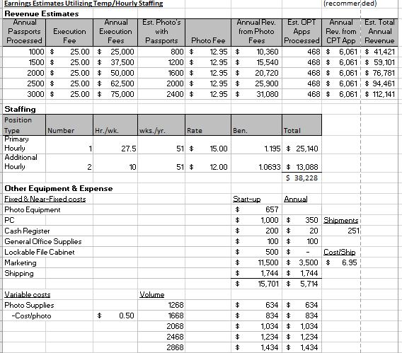
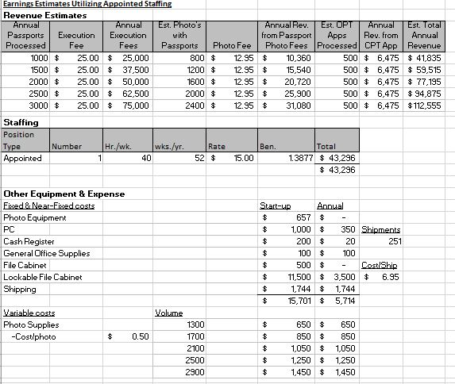
Financial Forecasting-IU

Slide 17
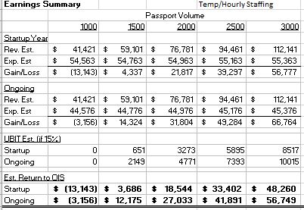
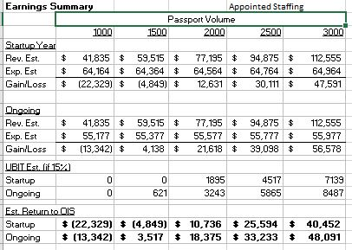
Financial Forecasting-IU

Slide 18
Staffing-UT
One Administrative Assistant at $30,000/year, subject to annual renewal
Reduced one student workers
Accountants assisted
Half-time Graphic Designer, Haft-Time Passport

Slide 19
Staffing
Notes:
This helps us manage staffing. Also have reports for each month, showing seasonal shifts. More efficient with payroll.

Slide 20
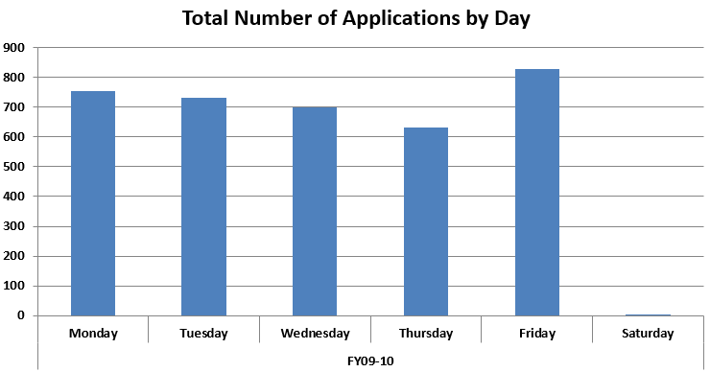
Staffing

Slide 21
Staffing-IU
3 part-time employees
Backed up by full-time staff
Balance between
limiting risks/start-up costs,
uncertainty of volume,
sick day coverage, and
turn-over

Slide 22
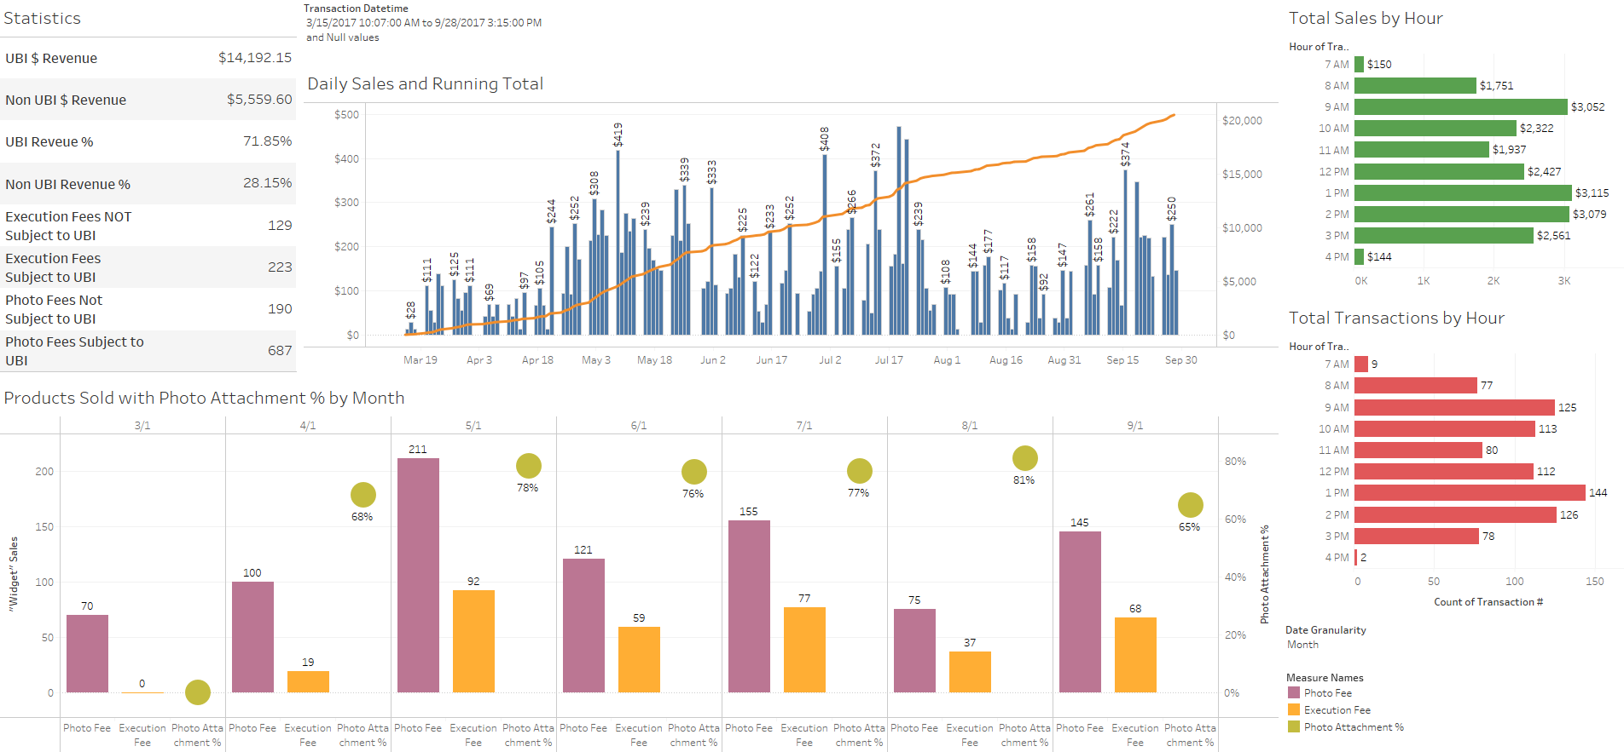
Staffing-IU

Slide 23
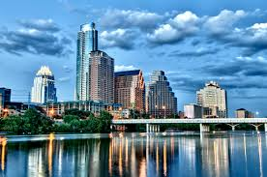
Market Size
Market Size: 2,000,000
Austin, TX – 1,000,000
2012 – 864,407
2013 – 885,400
2014 – 912,791
2015 – 931,830
2016 – 949,785
Surrounding Area: 1,000,000

Slide 24
Customer Segments
Notes:
Marketing data helps us figure out where our customers are coming from. This helps us tailor our marketing package more effectively.

Slide 25
UT Segment Marketing
Notes:
Moreover, we can drill down into the data, looking at where each customer segment hears about us. This helps us look at what marketing avenues are effective and which are dead weight. This, in turn, helps us be more efficient with our marketing budgets.

Slide 26
Non-UT Segment Marketing
Notes:
Others: YELP, KUT radio, Passport Days, Study Abroad Fairs

Slide 27
Marketing and Promotion
Market Size: Bloomington, IN and surrounding county
Population 145,000 (Bloomington, 85,000)
43,000 are students!
Post Office sales- approx. 4,000 the prior year
How much can we capture?
How can we grow the market?

Slide 28
Marketing and Promotion
Radio
Facebook
Local Newspaper
University Newsletters and websites
HR, Travel, Administrative, etc.
Appointments, Bursar Billing
Campus Partners
Provost Office
Office of Overseas Study
Office of First Year Experience
Notes:
County. 145k, 43k IU students. Town 95k, 43k IU students

Slide 29
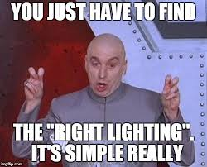
Logistics
Parking
Hours of Operation
Space
Front desk
Waiting area
Photo area with proper lighting
Signage
Overflow
New waiting system
Security

Slide 30
Customer Service
Walk-ins
Friendly, service with a smile
Answer questions
Returning calls
Accuracy
Quick turn-around
Photo quality
Retake photos
Kid friendly/cartoons/coloring books/baby beds
Spanish speaker
https://world.utexas.edu/passport/hours-location

Slide 31
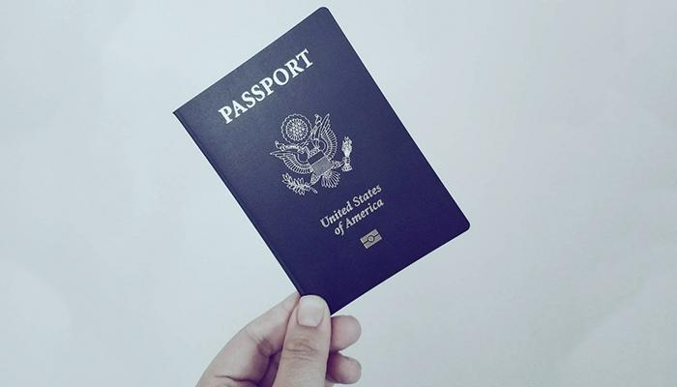
Benefits
Revenue stream for the International Office
Student services/Minimize barriers to Study Abroad
Service to the community
Improve community awareness of the office

Slide 32
Challenges
Customer Flow
Collaborations
Growing the market (IU)
Staffing

Slide 33
Questions?
Paul Butler
IU OIS, Director for Administration & Finance
Phone: 812-855-9073
Email: pabutler@iu.edu
Larry Phu
UT Austin, Director of Financial & Business Services
Phone: 512-471-2450
Email: Phu@austin.utexas.edu
Notes:
Add questions slide with contact info

