Slide 1
Managing Offices Abroad
Presentation by Awilda Marquez, Financial Director
AU Abroad, American University
Wil Biddle, Business Manager Education Abroad
University of Maryland
HEIBO Conference
University of Minnesota
October 4, 2016

Slide 2
Session Goals
Comparing Institutions
Examples of 4 offices abroad
What does managing offices abroad
look like?
Lessons Learned
Positive outcomes
Headaches
Open Discussion

Slide 3
AU Overview
American University (AU) is a Private University:
Tuition Dependent
3 AU Abroad (AUA) Centers: Brussels, Madrid and Nairobi
Facts and Figures (2015-2016)
870 undergraduate students studied abroad
135 approved programs in over 38 countries
Ranked 3rd for year-long and 12th for semester-long study abroad in 2015 IIE Open Doors Report
Ranked 8th for percentage of students studying abroad

Slide 4
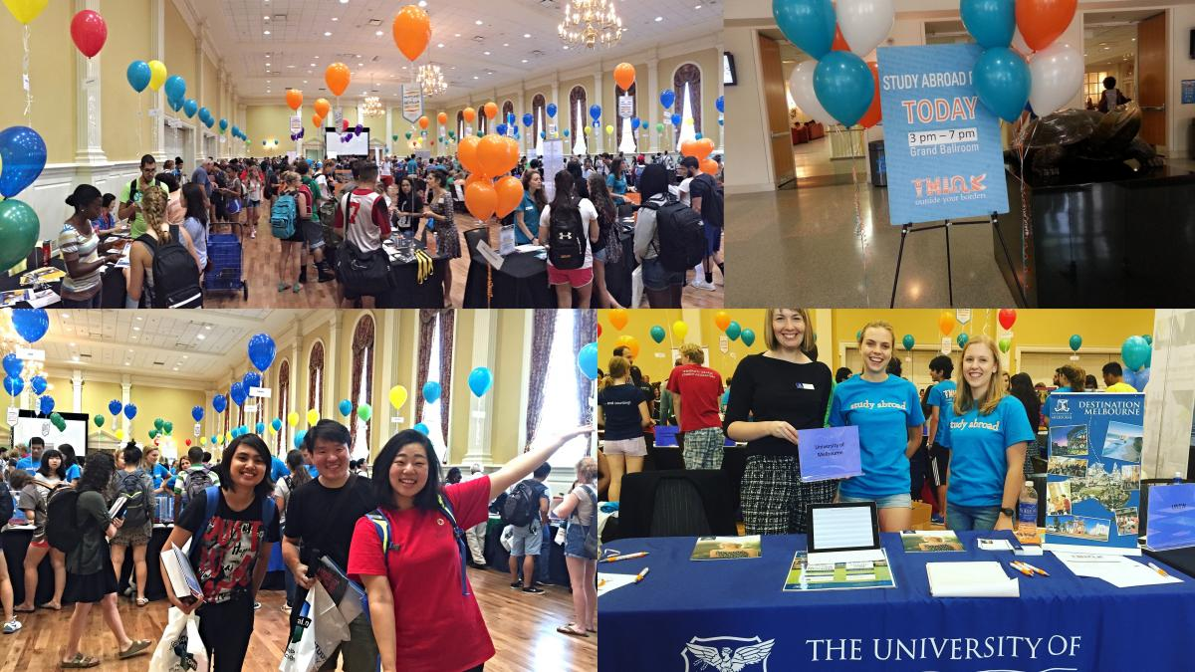
UMD Overview
University of Maryland (UMD) is a State University:
EA is self-supporting
10+ Maryland-In Locations
Offices managed abroad: Nice and Barcelona
Facts and Figures
1601 undergraduate students studied abroad (2015-16)
604 approved programs in
70 different countries
Ranked 19 nationally in
2012-13 IIE Open Doors Report

Slide 5
AUA Brussels
32 years in operation
Director is employee in USA and Belgium system
9 year lease
Contracts with faculty and staff as Independent Contractors
Academic travel and Internships are integral part of program

Slide 6
Maryland in Nice
In 28th year of operation (launched 1989)
Resident Directors are full-time faculty, alternating years
Lease multipurpose space on year-long commitment
Academic travel is integral part of program
Hybrid course offerings

Slide 7
AUA Nairobi
11 years in operation
Director - employee in Kenya and contractor in USA
2 year lease
Contracts with faculty as contractors and staff as employees

Slide 8
Maryland in Barcelona
Launched in 2010
Resident Director in contractor role
Contribution to office rent on term-by-term commitment
Site visits to US for recruitment and planning

Slide 9
What It’s Really Like
Time consuming
Team effort
Involves campus community
Academic units, registrar, etc
Regular maintenance and assessment needed
High level of trust needed
Have we trained them properly?
Heavy reliance of Program Director for success
Many don’t have knowledge or interest in financial aspects

Slide 10
Positive Outcomes
Control of expenses and spending
Global footprint and branding
Opportunities for staff and faculty on-site experience
Top quality program at lower cost-per-student
High level of autonomy for academic departments
Student enrichment and ongoing connection to the university

Slide 11
Headaches
Level of financial and legal risk of operations
Foreign Employment/Labor laws
Foreign taxation and incorporation – operating legally
Difficulties in anticipating costs, currency exchanges and fluctuations in enrollment
The time and energy on managing contracts, payments and assisting onsite staff
The need to continue to invest resources to add components to attract enrollment – fixed costs continue!

Slide 12
Open Discussion
What questions or comments do you have?

