Slide 1
Study Abroad Cancellations
HEIBO Conference, October 2016
Catalina Nguyen, Billing Specialist
Tony Fussy, Senior Accountant
Notes:
Next slide is Tony

Slide 2
Topics
Financial implications of cancellation
LAC programs
Global Campus Partner programs
Refund appeals process
Contractual language with onsite providers
Creating emergency funds for cancellations
Content developed for the Summit for Learning Abroad, August 2015, Minneapolis, Minnesota. Any unauthorized use, disclosure or distribution is strictly prohibited
Notes:
Next slide is Catalina

Slide 3
Cancellations
All that Hard work, and then there is a cancellation
Individually by student
Full program by U of M or LAC
Content developed for the Summit for Learning Abroad, August 2015, Minneapolis, Minnesota. Any unauthorized use, disclosure or distribution is strictly prohibited
Notes:
Next Slide Catalina

Slide 4
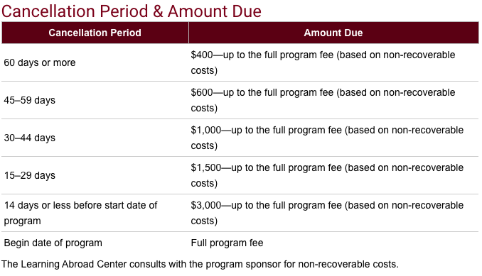
LAC Financial Considerations
Content developed for the Summit for Learning Abroad, August 2015, Minneapolis, Minnesota. Any unauthorized use, disclosure or distribution is strictly prohibited
Notes:
Next slide Tony

Slide 5
Global Partner Financial Considerations
Student cancellation: $400 APAAC, CISI, & any non-recoverable costs charged to student.
Program cancellation:
$50 application fee refunded to student, charged to department.
Base cost of $600-$2400 charged to department if less than 6 students in confirmed status based on timing of cancellation.
$400 APAAC charged to the unit, if 6 students or more in the confirmed status.
Notes:
Next is Catalina

Slide 6
Appeal for Refund Process
Appeal Process:
http://umabroad.umn.edu/students/policies/finances/refundprocess
Extenuating Circumstances
Medical
Illness/Death in the Immediate Family
Academic
Military Action
Unanticipated Change in Financial Situation
Other
Content developed for the Summit for Learning Abroad, August 2015, Minneapolis, Minnesota. Any unauthorized use, disclosure or distribution is strictly prohibited

Slide 9
Refund Appeal Forms Required
Appeal for Refund Form
Personal Statement explaining the situation
Medical Refund Form (if applicable) signed by medical professional
Any other applicable forms (bankruptcy documentation, death certificate, etc.)
Content developed for the Summit for Learning Abroad, August 2015, Minneapolis, Minnesota. Any unauthorized use, disclosure or distribution is strictly prohibited

Slide 10
The Refund Appeal Committee
Choose members with different interests
Health/safety
Programming
Finance
Other
Separate finance/programming issues from the appeal circumstance. What is truly best for the student.
Content developed for the Summit for Learning Abroad, August 2015, Minneapolis, Minnesota. Any unauthorized use, disclosure or distribution is strictly prohibited

Slide 11
Proactive Measures
Contract Language
Cancellation Considerations
Provider agrees to make an exception to their cancellation policy per the request of the Learning Abroad Center’s Appeal Committee on cases where the students appeal their program charges with the LAC and where the LAC feels compelled to try to reduce the charges that were billed. Provider agrees to give LAC a break-down of actual non-recoverable costs in such compelling situations and Provider agrees to equally split the loss on those cases with the LAC. LAC agrees to share appeal documentation to support the loss by each party in case of an audit.
Content developed for the Summit for Learning Abroad, August 2015, Minneapolis, Minnesota. Any unauthorized use, disclosure or distribution is strictly prohibited

Slide 13
Appeals
Mental health & study abroad
29% of all medical appeals are mental health related
18% of total refund appeals are mental health related
Encourage students to disclose health (physical or mental) situations during application/confirmation process.
Content developed for the Summit for Learning Abroad, August 2015, Minneapolis, Minnesota. Any unauthorized use, disclosure or distribution is strictly prohibited
Notes:
Next Slide is Tony

Slide 14
Emergency Funds
How do you pay for the appeals?
What if there is a “real” emergency?
Getting approval to develop a fund.
Starting a fund
What is your ultimate goal?
Start small, earmark any overages.
Fund balances in other institutions.
Who is allowed access to this fund?
Content developed for the Summit for Learning Abroad, August 2015, Minneapolis, Minnesota. Any unauthorized use, disclosure or distribution is strictly prohibited
Notes:
Had about $16,500 in refund appeals we ate/absorbed in 14-15

Slide 15
Questions
Content developed for the Summit for Learning Abroad, August 2015, Minneapolis, Minnesota. Any unauthorized use, disclosure or distribution is strictly prohibited

Slide 16
Contact Information
Catalina Nguyen
612-624-5240
lacfin1@umn.edu
Tony Fussy
612-624-8898
gpsfin1@umn.edu
Content developed for the Summit for Learning Abroad, August 2015, Minneapolis, Minnesota. Any unauthorized use, disclosure or distribution is strictly prohibited

