Slide 1
Financial Management of Exchanges in an RCM Environment
DENISE GARDINER
dagardin@iu.edu
October 3, 2016

Slide 2
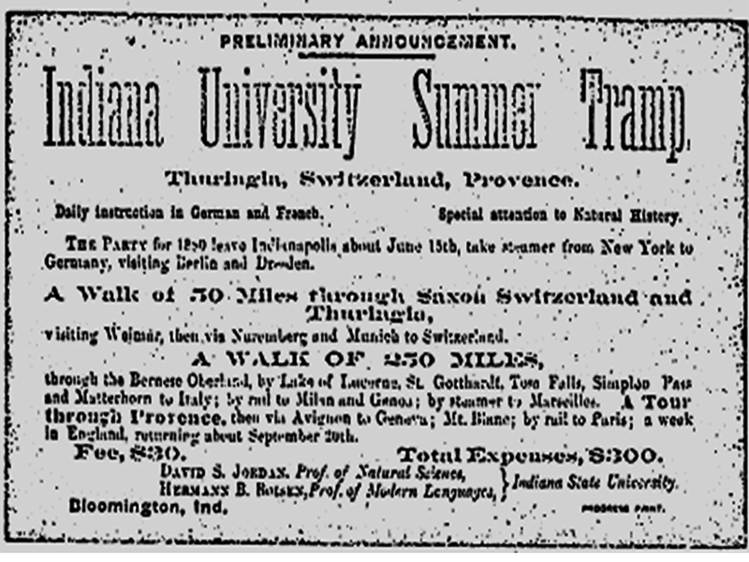
History of Study Abroad at IU
19th Century Origins
First US programs in Latin America and Soviet Union in 1959
Creation of Office of OVST in 1972
Central staff of 6 now grown to 14
Centralized program approvals; mixed responsibility for administration

Slide 3
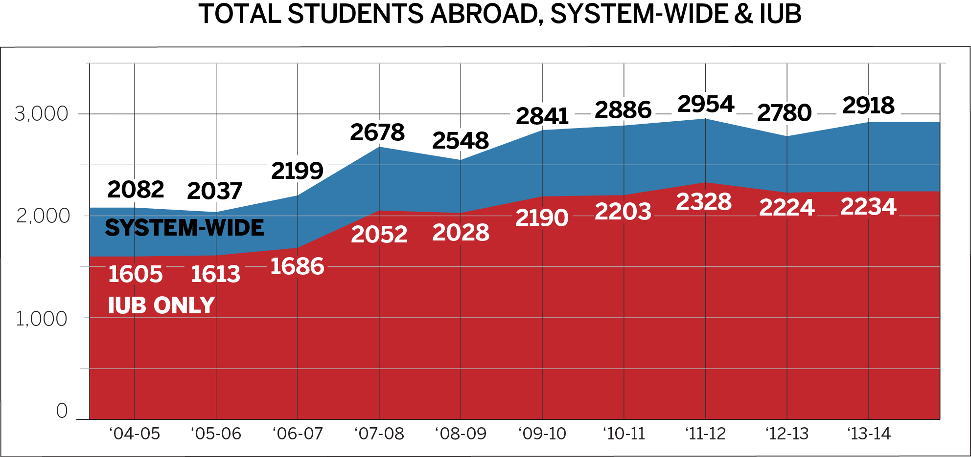

Slide 4
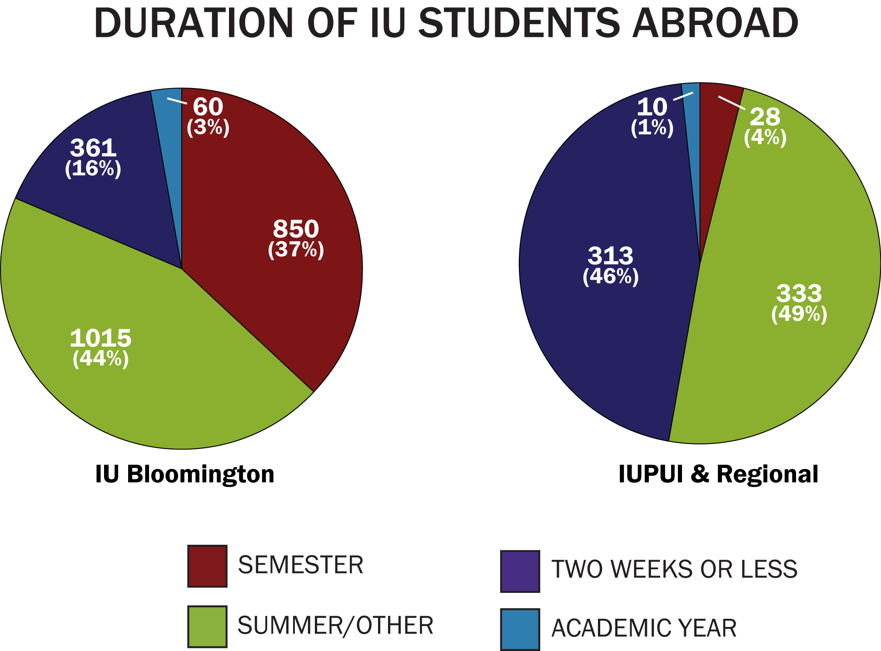

Slide 5
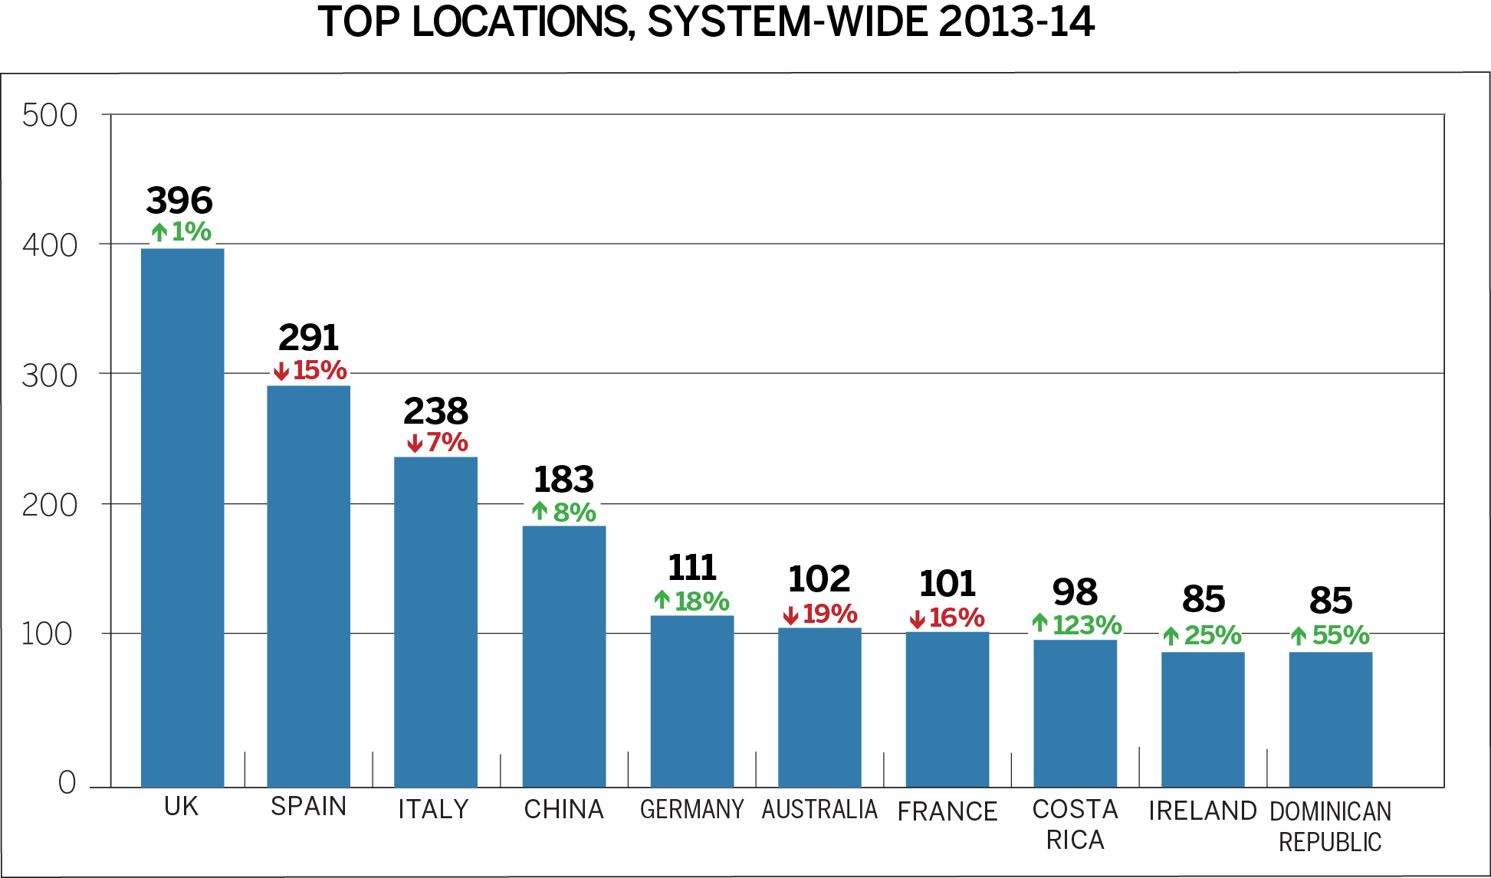

Slide 6
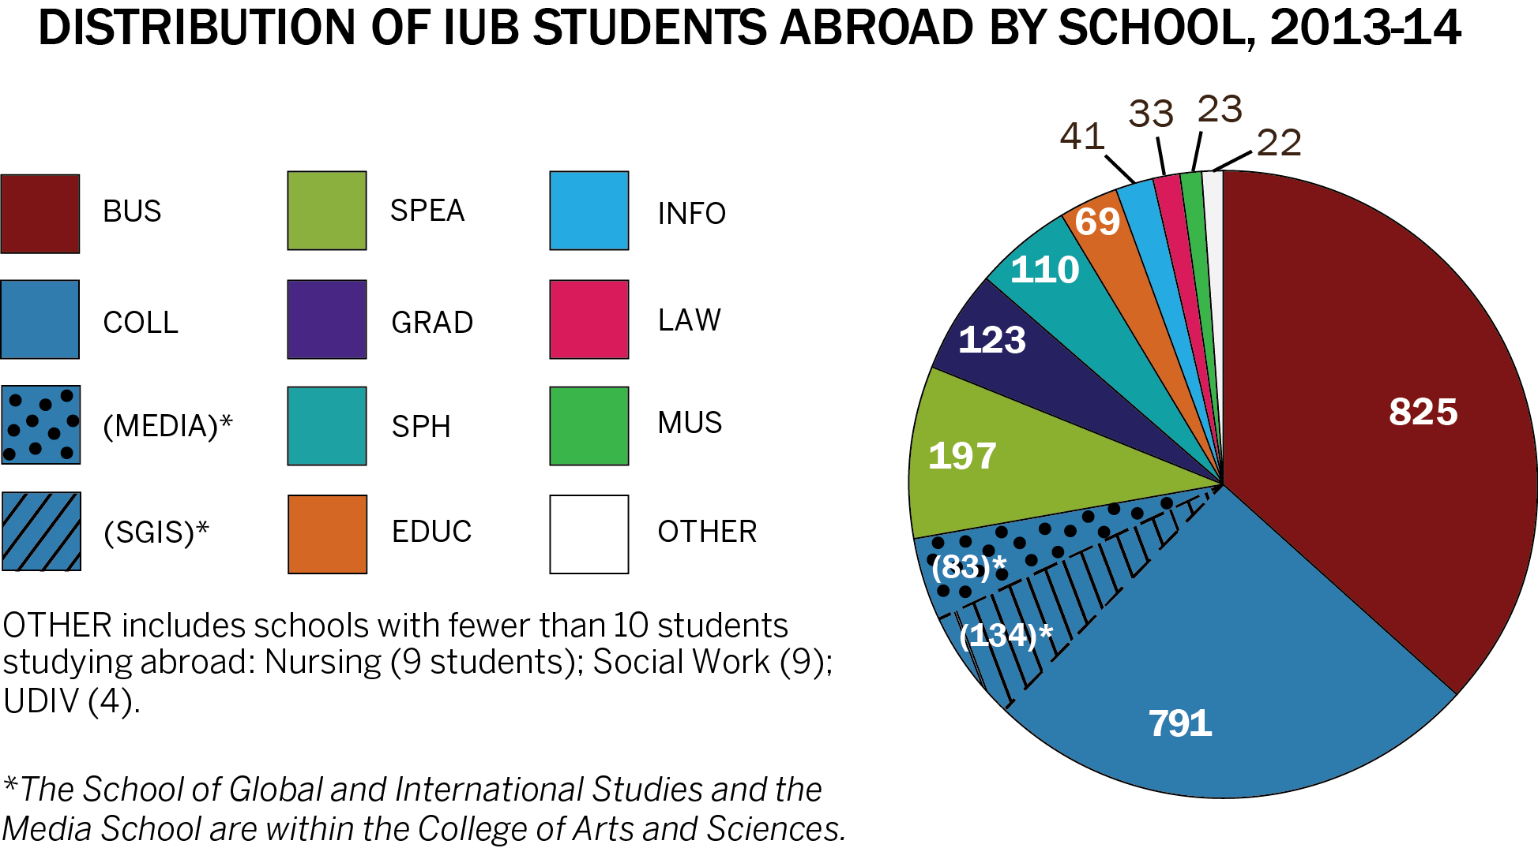

Slide 7
Three types of program models
Centrally Administered
Faculty-led
Customized
Consortia programs (Madrid, Aix, Bologna, Freiburg)
Historic exchanges - open to all fields of study
Co-Sponsored (most central, some unit-specific)
Third-party providers (CIEE, IES Abroad, others)
Direct enrollment foreign university
Unit-based
Faculty-led
Unit-to-unit exchanges - major field restricted both directions

Slide 8
Context for exchanges at IU
President’s initiative to streamline number of institutional partnership agreements from 500 to about half that. Agreements should be active, complementing IU’s strengths and furthering IU’s fundamental missions.
Responsibility Centered Management (RCM) budgetary system a disincentive to expansion of campus-wide undergraduate student exchanges, even with highest priority strategic partners.
Within one academic unit, RCM disincentivizes exchanges due to non-resident/resident differential and flat fee tuition/market share.
The vast majority of international students on IU’s campus are not exchange students (< 200 of ~7,000 international students); same on the outgoing/study abroad side (< 200 of ~2,200 study abroad participants).

Slide 9
Campus-wide exchanges
Limited (grandfathered-in) agreements:
Australia: Australia National University, University of Adelaide, University of Western Australia and University of Wollongong
England: University of Kent
France: Universite de Provence, Sciences-Po
Italy: University of Bologna
Japan: Nanzan University
Number of slots fixed – fear losing budget allocation

Slide 10
Unit-to-unit Exchanges
How did we make this happen?

Slide 11
2008 Student Exchange Fee Remission
POLICY
PROCEDURE

Slide 12
Takeaways Labor intensive Units must sustain agreement Balance Questions?

